Slide 1
Unsupervised Video Object Segmentation with Motion Based Bilateral Networks
Sonia Rao
QRG, Feb 13th

Slide 2
Project: Segmenting Cilia
Cilia: The microscopic hairs on cells
Ciliopathy: Genetic disorder characterized by malfunctioning cilia
Detection of cilia in video data and classification of ciliary motion is clinically compelling.

Slide 3
Previous attempt
Obtained segmentation maps for three distinct behaviors: Normal, Wavy, Stiff (thanks Dr. Quinn)
Generated four different optical flow fields for each frame of each video, typically variants of Farneback and Horn-Schunk methods
Trained a 3-tier stacking estimator on optical flow inputs and segmentation maps
Achieved decent accuracy but … reliance on pre-segmented masks = no good!

Slide 4
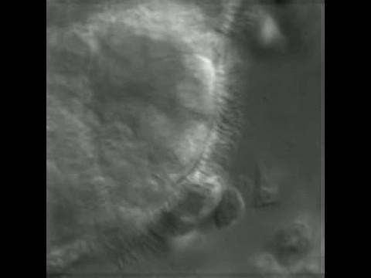
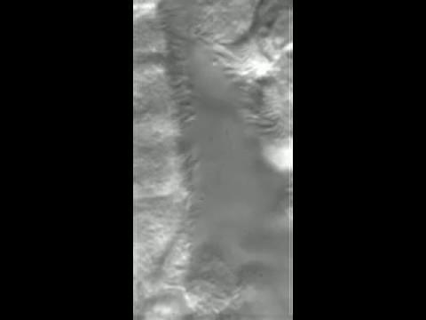

Ciliary Motion examples
Notes:
Dr Quinn gave each individual pixel a binary label …. No thanks!

Slide 5
Unsupervised Video Object Segmentation
Unsupervised: No known target objects, model must rely on both motion cues (optical flow) and spatial cues to differentiate between a foreground and background
Can be hard to do! Previous deep learning architectures trained on both temporal and spatial inputs have lead to high bias
(e.g. in a video of moving and stationary cars, model learns that cars move and thus all cars, stationary and moving, must be part of the foreground)
Several problems of VOS are addressed by: Motion Based Bilateral Networks

Slide 6
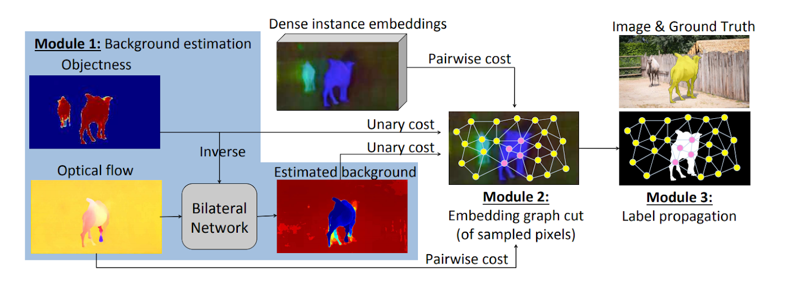
3 Step pipeline
Notes:
Combines objectness with optical flow to learn direct relationship rather than learning from concatenated feature set. Refined background prob map is combined with deep instance embeddings to obtain an embedding graph cut. This is essentially a set of representative pixels, known as seeds, for each frame. Those seeds are then connected via graph edges if there are either appearance or temporal disconitnuities. These seeds are then classified based on original objectness map, and then propagated to all pixels in original sample

Slide 7
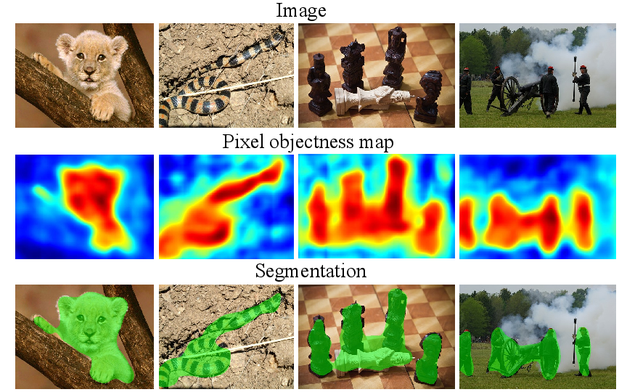
Part 1: Background Estimation
BNN’s can be used to build direct correspondence between motion and background, rather than just using concatenated set of spatial and temporal features
Objectness map: pixel-wise probabilities map (via ResNet)
Bilateral network thresholds and inverts the objectness map to get background estimation (non-objects), expands background using optical flow motion patterns to include static objects

Slide 8
What is a bilateral network?
Bilateral network: Bilateral filtering with learnable filters instead of default Gaussian filters!
Bilateral filtering:
Construct bilateral grid
Splat features to multi dimensional bilateral grid
Convolution on high dimensional grid (learnable filters)
Slice the filtered features back to samples

Slide 9
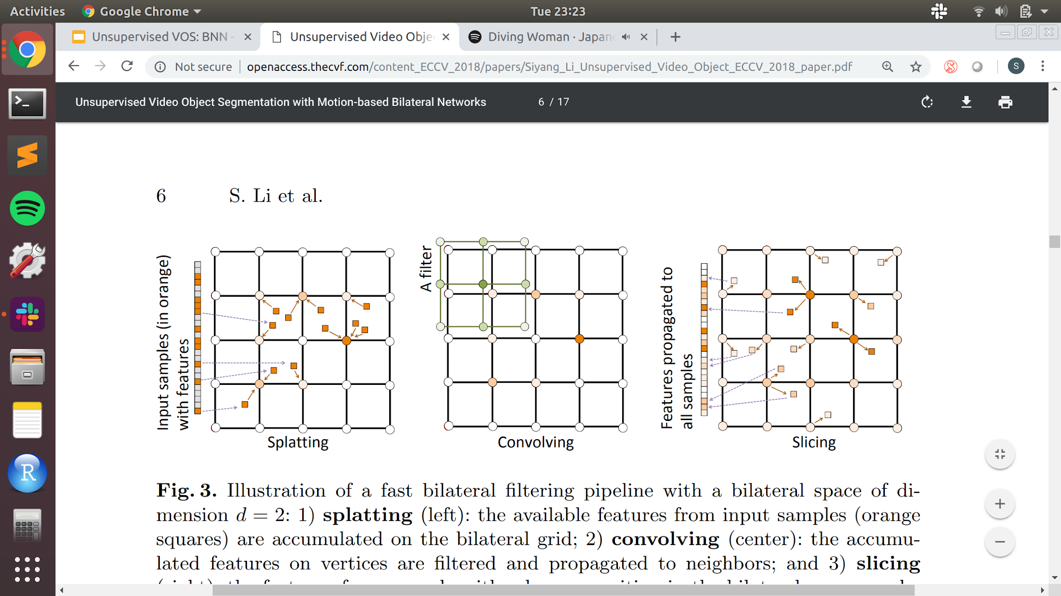
Fast bilateral filtering: 2-D example

Slide 10
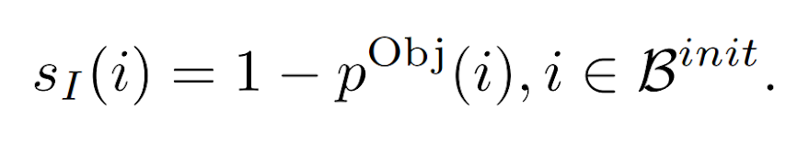
Constructing Bilateral gridspace
Position vector: f = (dx, dy, x, y)ᵀ where (dx,dy) = optical flow vector (u,v); (x,y) = pixel position
Bilateral gridspace becomes regular grid with dimensions: (u, v, x, y), partitioned into rectangles
To obtain a set of input samples for splatting, we locate the non-object pixels by inverting the objectness map (spatial output of neural network, in this case ResNet)
Where initial background = β(init); SI(i) = feature vector of sample i; p(obj) = objectness score, soft background vote

Slide 11
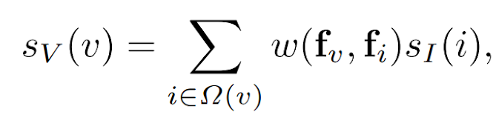
Splatting
Essentially accumulating background votes on vertices of grid
The feature on the vertex v is obtained by accumulating the features of input samples in neighbor rectangles
where 𝛀(v) = neighborhood of vector v,
w(fv,fi) = weight function of influence from sample i on vertex v, (nearest neighbor indicator)
SI(i) = background vote
Notes:
Essentially accumulating background votes on vertices of grid

Slide 12
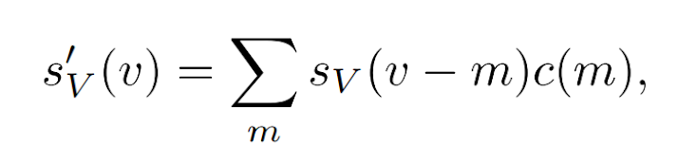
Convolving
filtered feature on vertex v becomes:
Where c(m) = 4-Dimensional learnable filter to propagate votes to neighboring vertices
Learnable filters compost the Bilateral Neural Network which is trained by minimizing loss between So(O0 output sample o and target feature o

Slide 13
Slicing
propagated votes are forwarded to the remaining pixels on the same frame, based on their optical flow and spatial locations

Slide 14
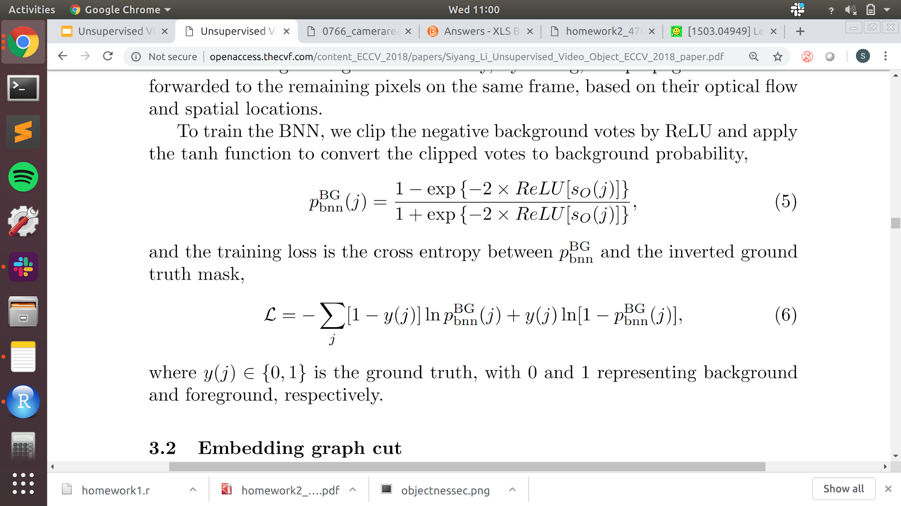
Training BNN
we clip the negative background votes (weighted and filtered sample pixels) by ReLU and apply the tanh function to convert the clipped votes to background probability:
and minimize training loss: the cross entropy between pBG and the inverted “ground truth mask” (assuming it’s the thresholded objectness map?)

Slide 15
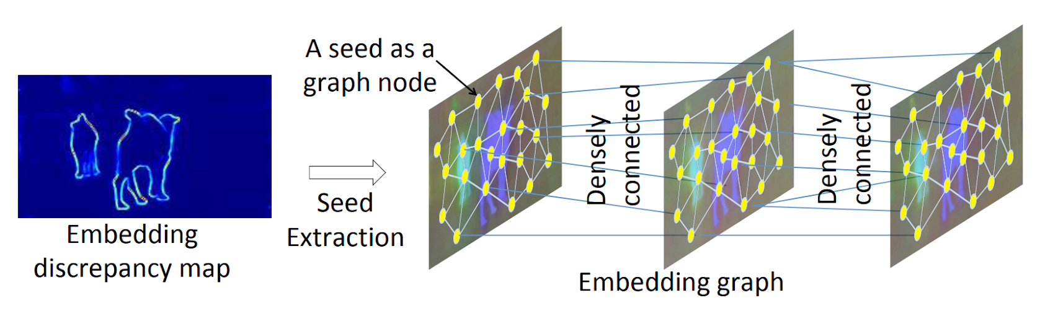
Part 2: Embedding Graph Cut
We extract seeds based on the embedding discrepancy map, which become graph nodes. Edges connect nodes that are spatial neighbors OR from consecutive frames

Slide 16
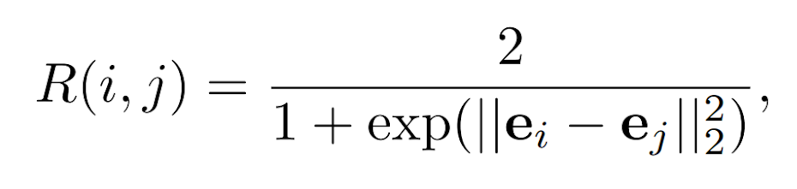
Instance Embedding
The embedding e is a representation vector of a pixel, and similarity of two embeddings is defined by the probability that they both belong to the same object:
The instance embeddings are explicitly trained to encode pixel-wise similarity by minimizing the cross entropy between R(i, j) and the “ground truth identical instance indicator”

Slide 17
Building Embedding Graph
Graph is built from a small subset of pixels that are approximately evenly distributed in the spatial space and located at stable points of the instance embedding map. (representative pixel sample)
These sampled pixels are called “seeds” and initially obtained via cost minimization.
To classify the seeds on frame t, we build a graph based on seeds from frames (t − 1) to (t + 1)
Given the seeds on a frame, we identify the closest seed to every pixel, and we link the seeds with a graph edge if two neighboring pixels are closest to different seeds. These edges are called spatial edges. For seeds from consecutive frames, they are densely linked to yield temporal edges.
Notes:
What is the cost minimization?? Uh

Slide 18
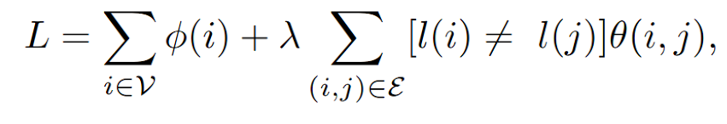
Graph Cut
Given the instance embeddings describing pixel similarity, the objectness score and background score from the BNN, we adopt the graph cut method to classify seed pixels by minimizing a cost function.
Where 𝝓(i) is the unary cost for each seed in seed set; 𝜃(i,j) is pairwise cost for all pairs in set of graph edges ε; l(i) is the assigned label {0,1} of seed i

Slide 19
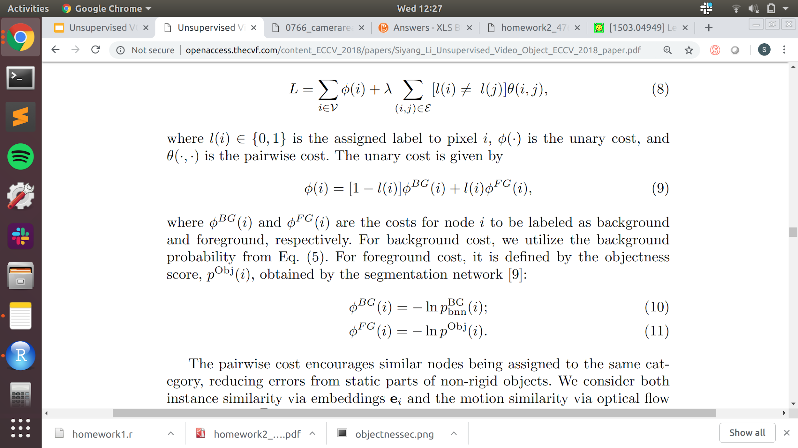
Unary Cost
Given by:
Where 𝝓BG and 𝝓FG are the costs of node i being labeled BG or FG

Slide 20
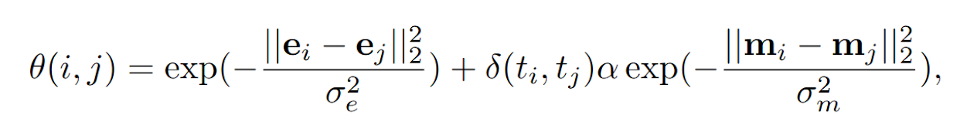
Pairwise Cost
The pairwise cost encourages similar nodes to be assigned to the same category = reduces errors from static parts of non-rigid objects; if seeds i and j are from different frames, optical flow is ignored
Motion similarity (from optical flow)
Instance similarity
Indicator function
Std. deviation of Gaussian kernel
Notes:
Neighbors that are furthers are

Slide 21
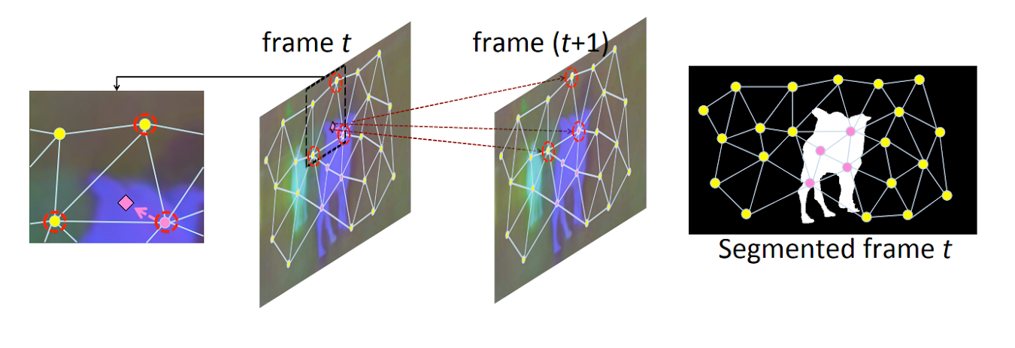
Part 3: Label Propagation
Given an arbitrary pixel, i, with its temporal-spatial location denoted by (xi , yi , ti)ᵀ , we can identify its neighboring seeds on frame ti by finding its spatially closest seed and the spatial neighbors of that seed in the graph

Slide 22
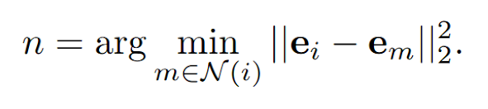
Label Propagation
Neighboring seed set for pixel i is denoted by N(i). Among the seeds in N (i), the one with the shortest embedding distance to i is found by:
The label of seed n is given to pixel i!
Repeat for all embeddings in the original dense instance embedding map

Slide 23
Final Step
Because the resolution of the dense embedding map is lower than the original video, we upsample the probability map using the multilinear interpolation to the original resolution and further refine it with a dense conditional random field
Multilinear interpolation: interpolates values to get same dimension values as original objectness map
Notes:
What is crf who’s to say hmm

Slide 24
Cilia project: Good option?
I think so!
Curbs high learning bias (e.q. Networks only determine that cilia are on cells)
Includes static objects in region of interest, great for dyskinetic and rigid cilia types
Computationally efficient due to sparse extraction process for embedding graph of seeds, good for decently large videos like cilia data
Thoughts?
Notes:
U net

Slide 25
The end thank you! :-)

Slide 26
Papers
Unsupervised Video Object Segmentation with Motion-based Bilateral Networks, Li et. al.
Semantic Instance Segmentation via Deep Metric Learning, Fathi et. al.
Instance Embedding Transfer to Unsupervised Video Object Segmentation, Li et. al.
Learning Sparse High Dimensional Filters: Image Filtering, Dense CRFs and Bilateral Neural Networks, Jampani et. al.

